Slide 1

R In a Hurry
Data Science FunConference
Derren Barken

Slide 2
Agenda
RGui and RStudio
STAR data (Standardized Testing and Reporting)
Introduction to Vectors
Introduction to Data Frames
Making Plots
Introduction to modeling: linear regression

Slide 3
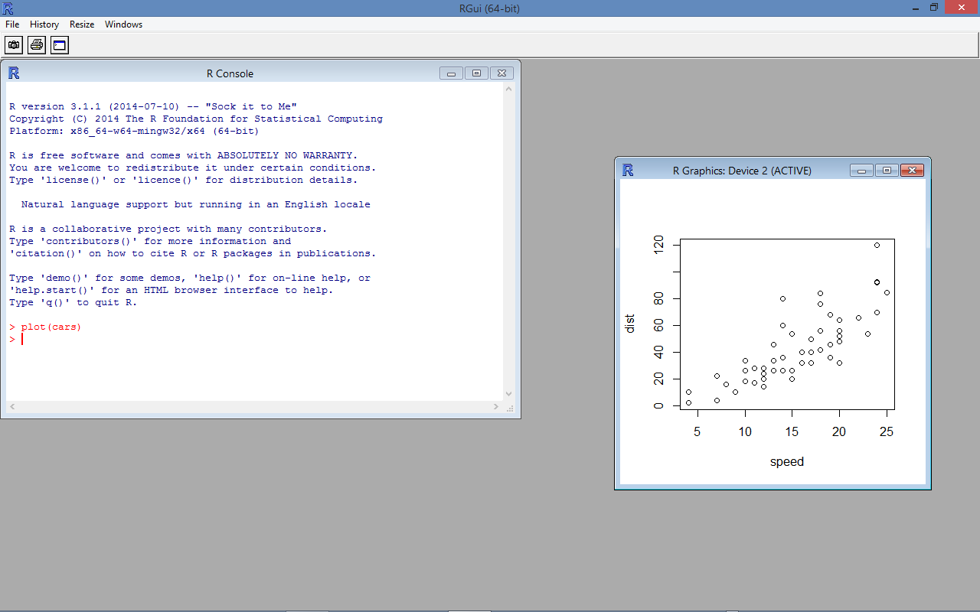
This is RGui

Slide 4
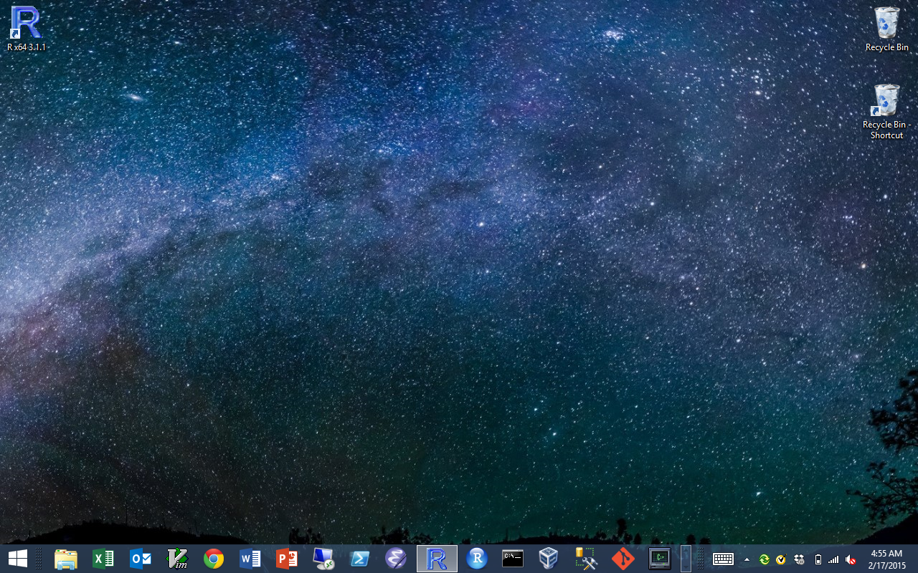
RGui is installed by default

Slide 5
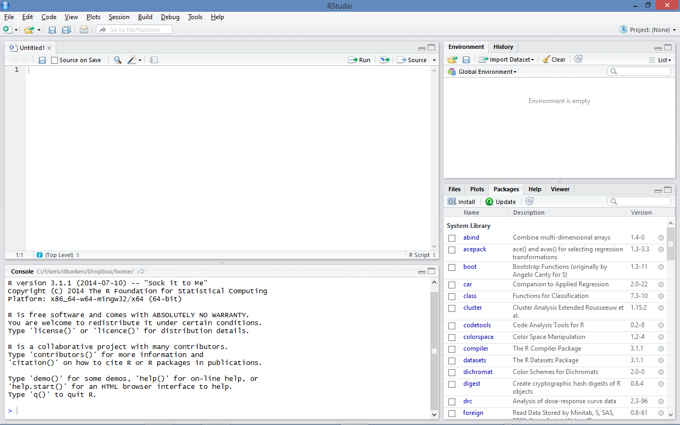
This is RStudio

Slide 6
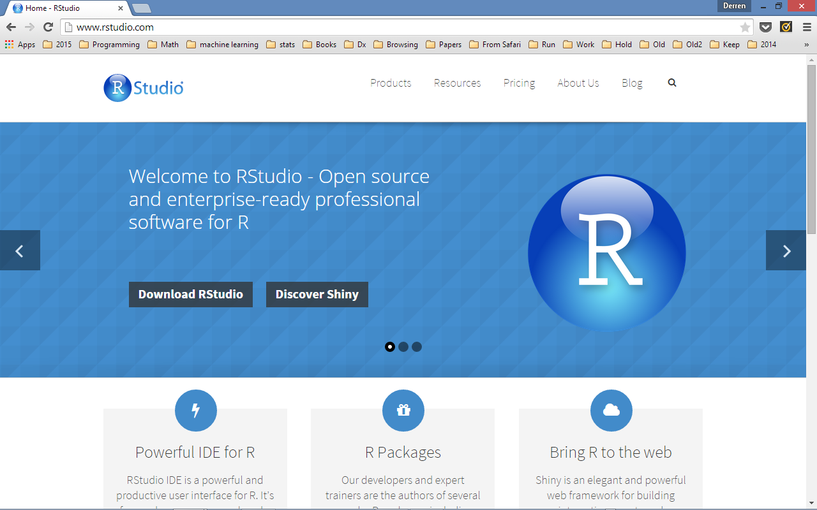
RStudio is an integrated development environment (IDE) for R

Slide 7
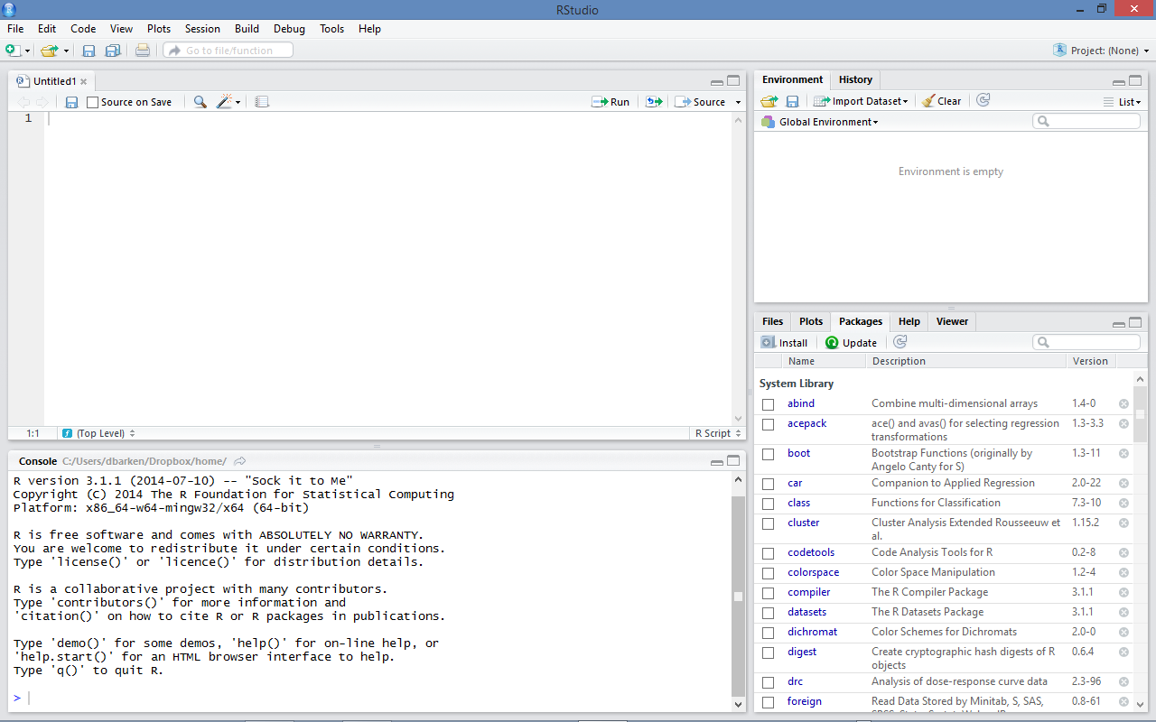
Rstudio has four panels
3
1
4
2

Slide 8
Panel 1 is a text file editor
1

Slide 9
Panel 2 is a console
2

Slide 10
Panel 3 has two tabs:
Environment and History
3

Slide 11
Panel 4 has five tabs:
Files, Plots, Packages, Help, and Viewer
4

Slide 12
Use these buttons to show/hide panels

Slide 13
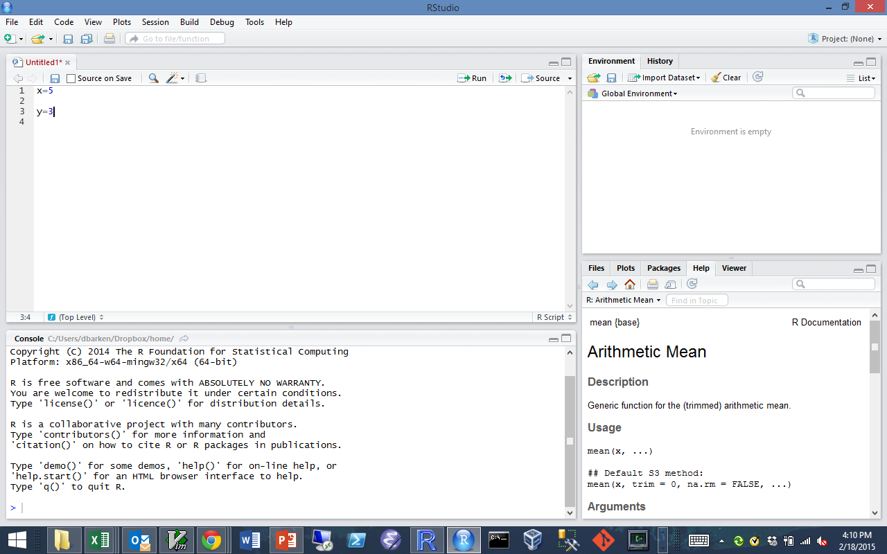
Use the Run button to send a line or selection to the console. The Source button sends the whole file.

Slide 14
We are going to look at some built in data.
Go to the Packages tab and click on “datasets”

Slide 15
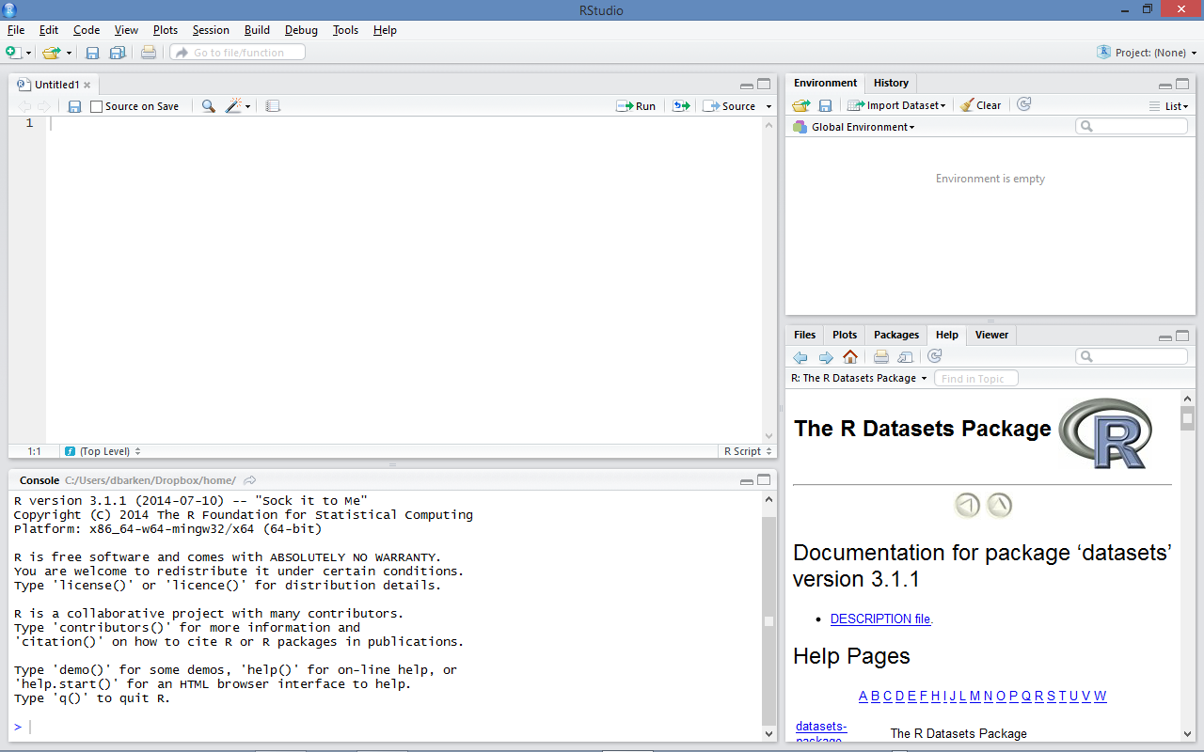
Make the panel taller

Slide 16
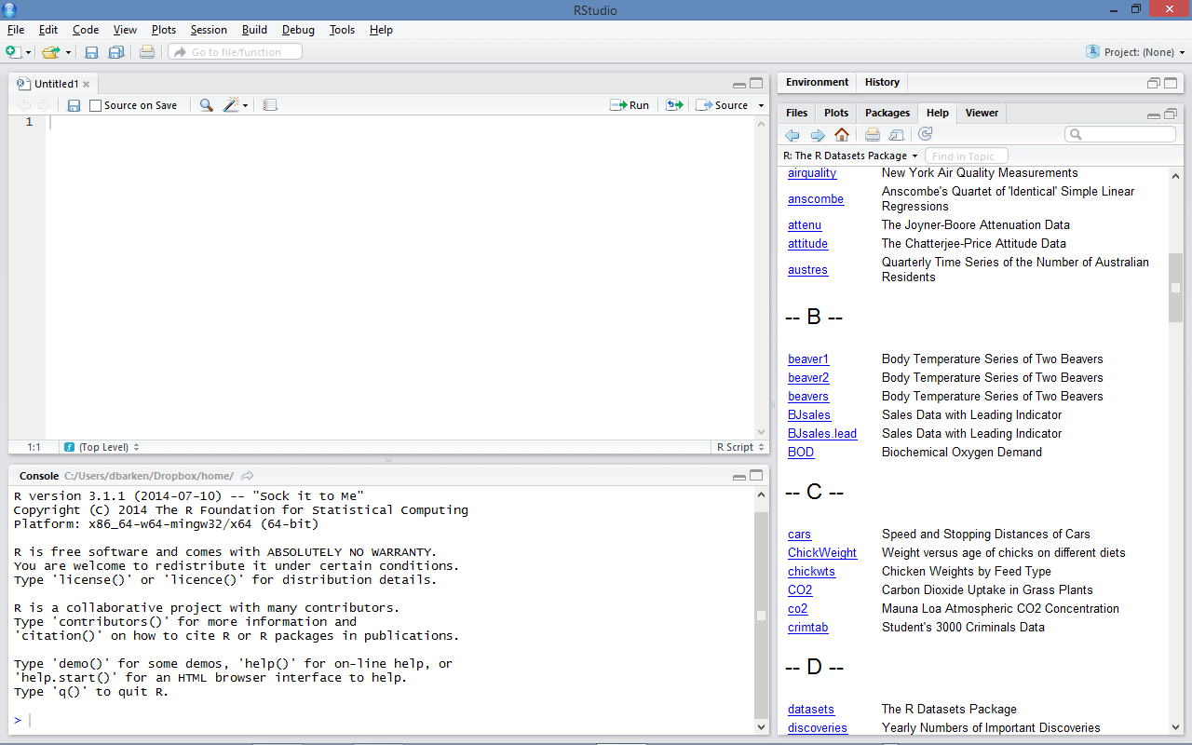
Scroll down to and click on “cars”

Slide 17
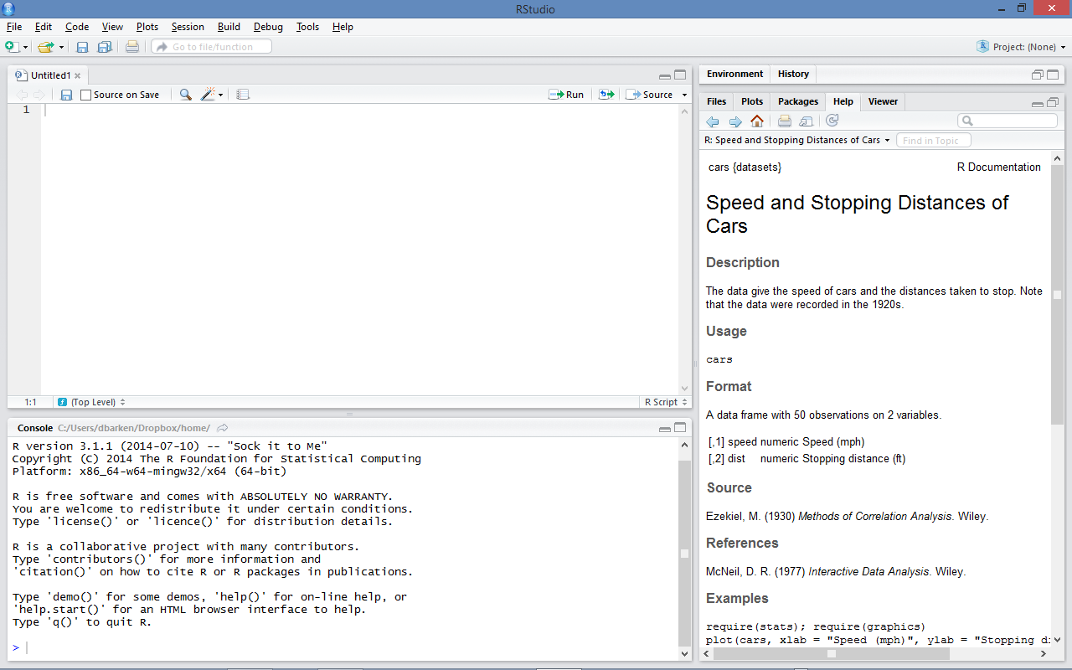
Notice that RStudio switched to the “Help” tab

Slide 18
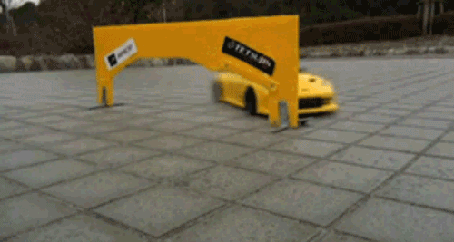
What is “cars”?
Thanks to the “datasets” package, we have a built in Data Frame called “cars”.
What is a Data Frame? We will go over that in some detail.
For now, think of a data frame as a “table” of data.
Let’s look at the cars data frame…
(Stay with us…)

Slide 19
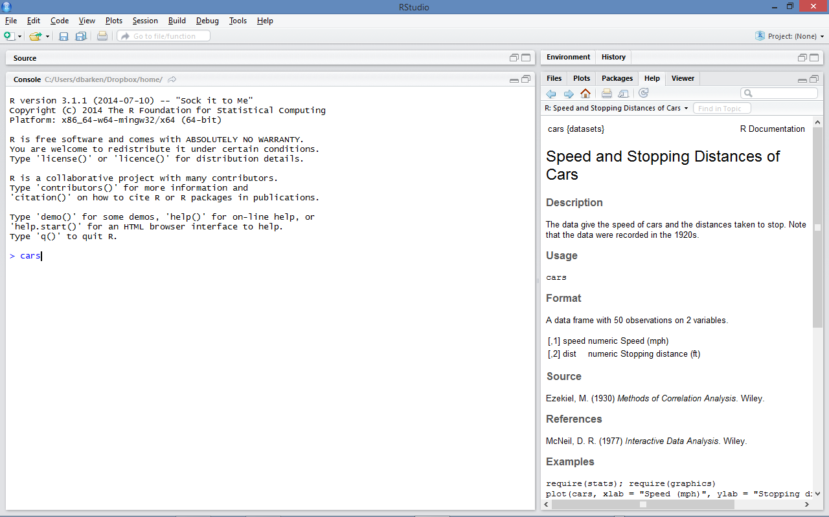
Type “cars”

Slide 20
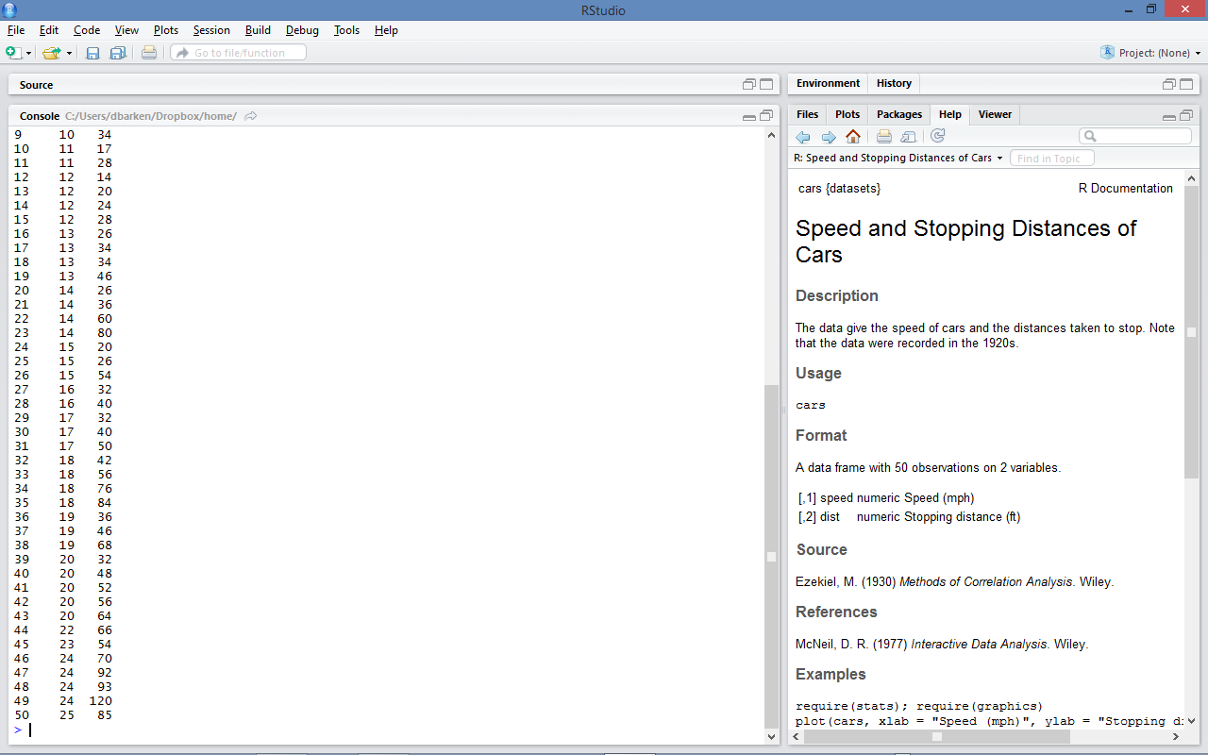
Oops – “cars” has 50 rows.
Let’s try something else.

Slide 21
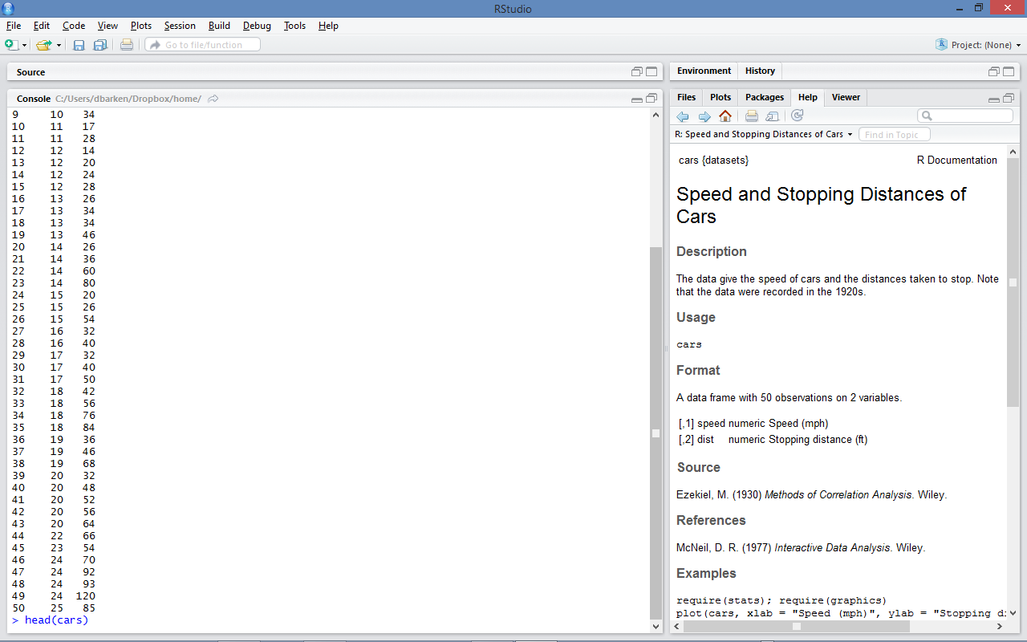
head(dataframe) is a function that shows the top 6 rows
Type “head(cars)”

Slide 22
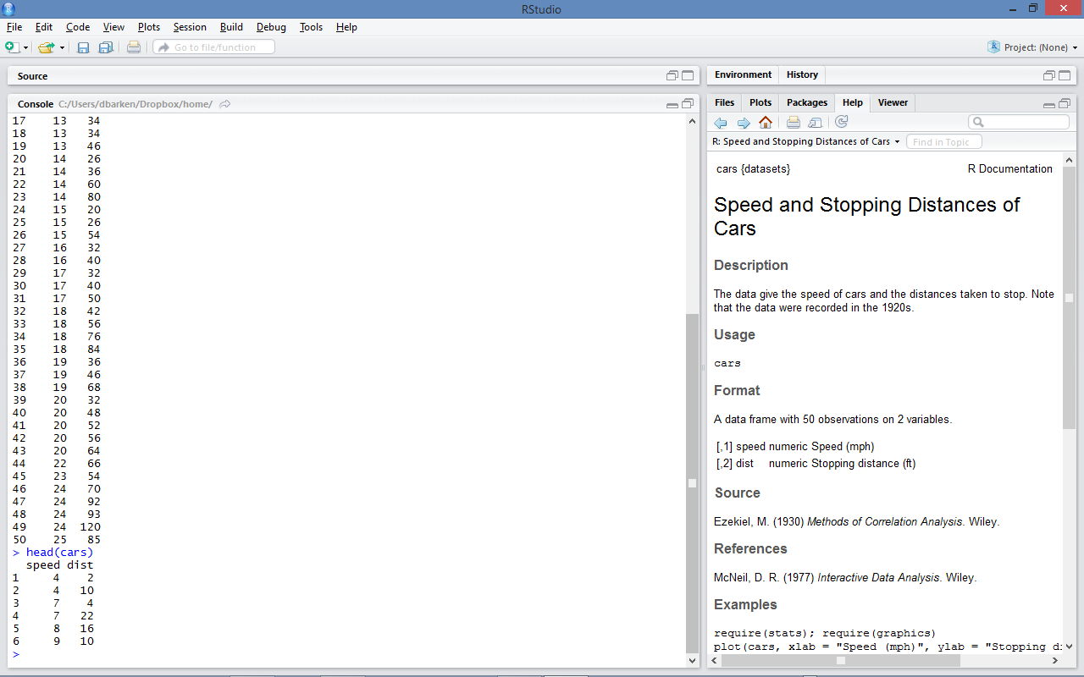
That’s better.
Now we can see that “cars” has two columns: speed and distance

Slide 23
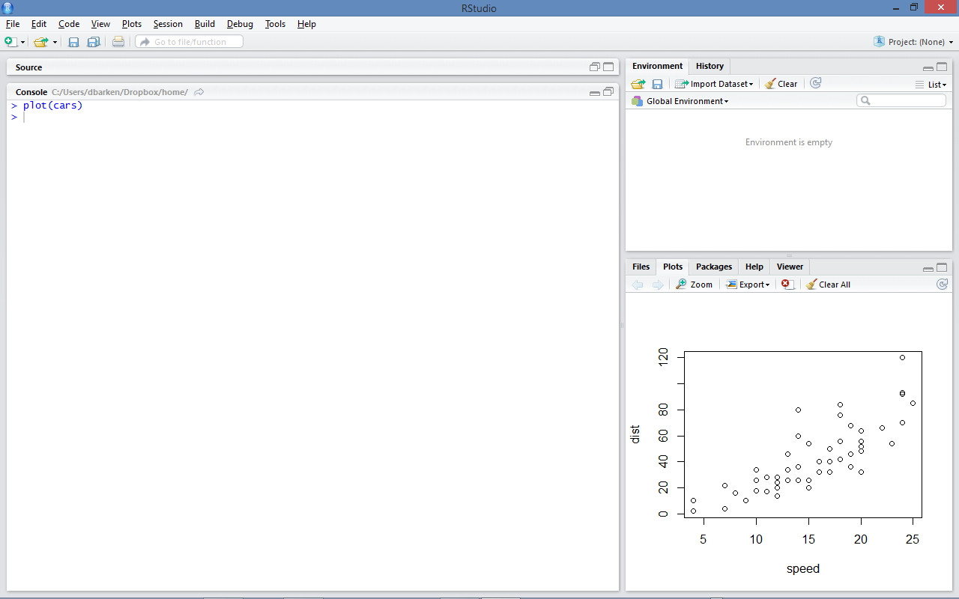
How easy is it to make a plot?
Pretty easy.

Slide 24
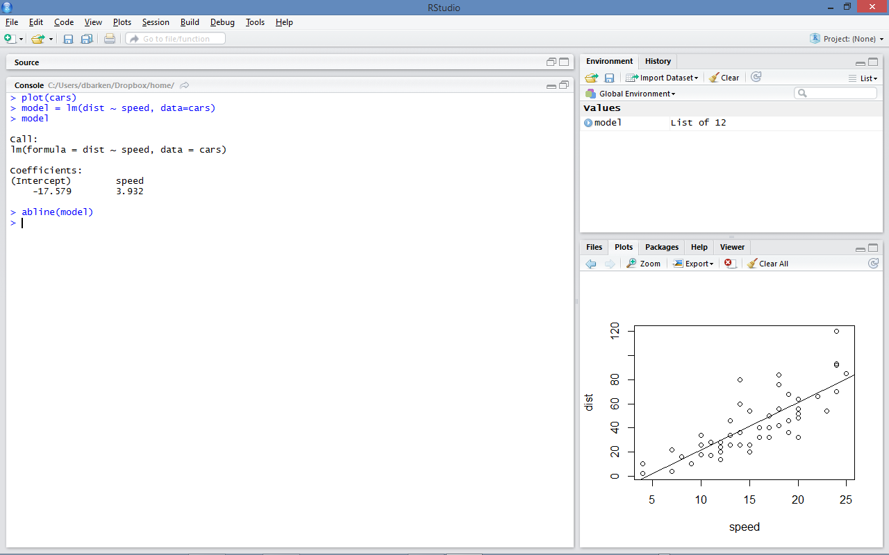
How easy is it to make a model?
Pretty easy.

Slide 25

So what’s the plan?
We are going to learn more about data frames, plotting, and models.
But first, a brief intermission…
Let’s introduce our star dataset for today.
It is called…

Slide 26
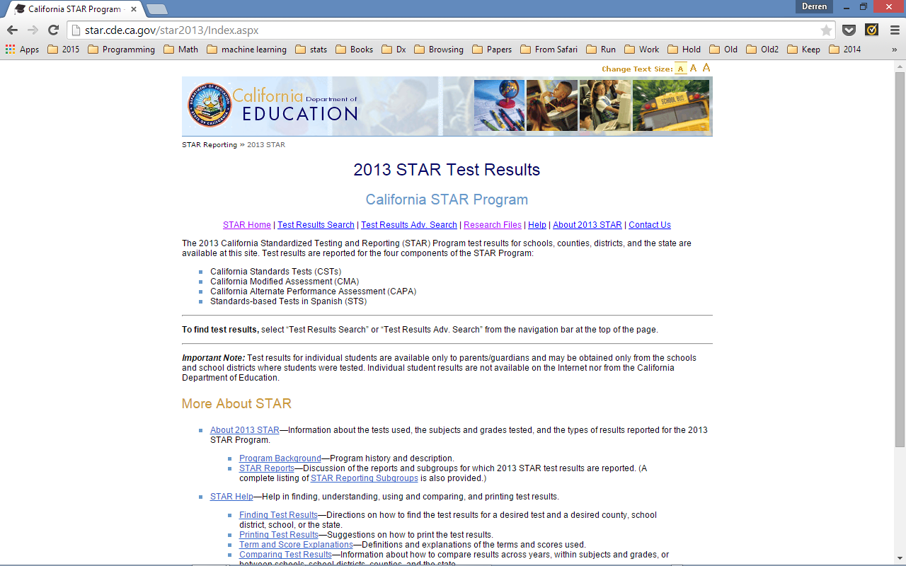
STAR
Standardized Testing And Reporting

Slide 27
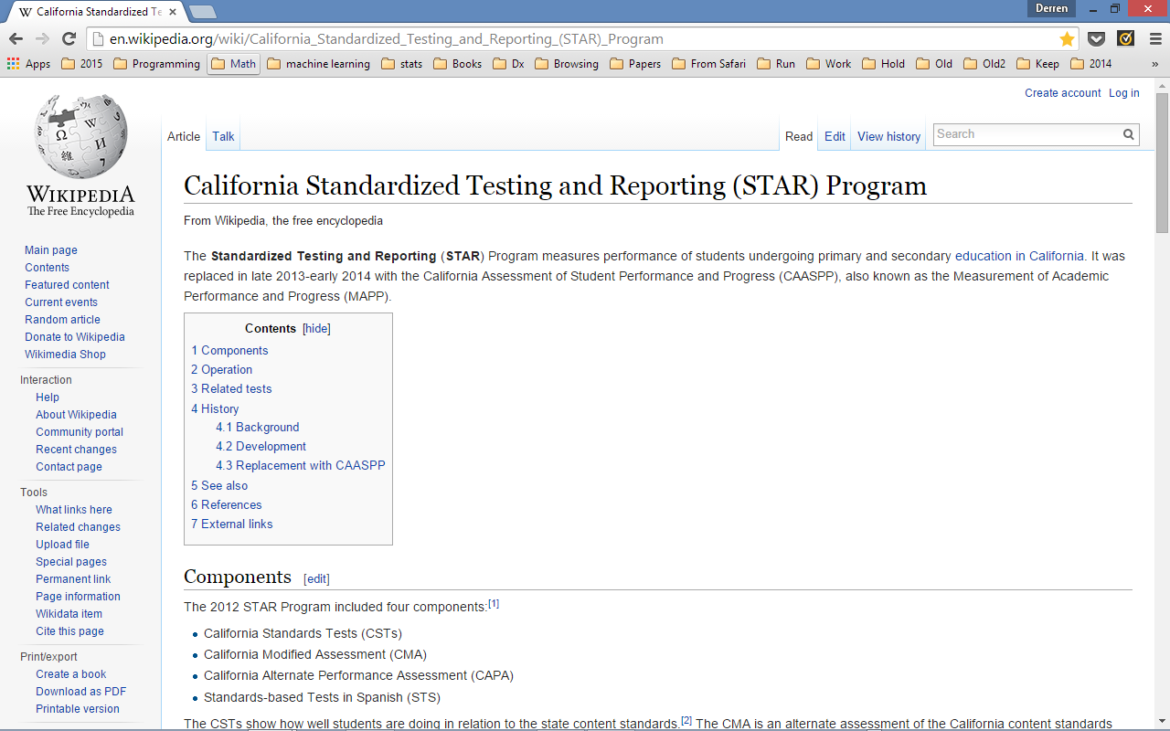
Tell us more, Wikipedia…

Slide 28
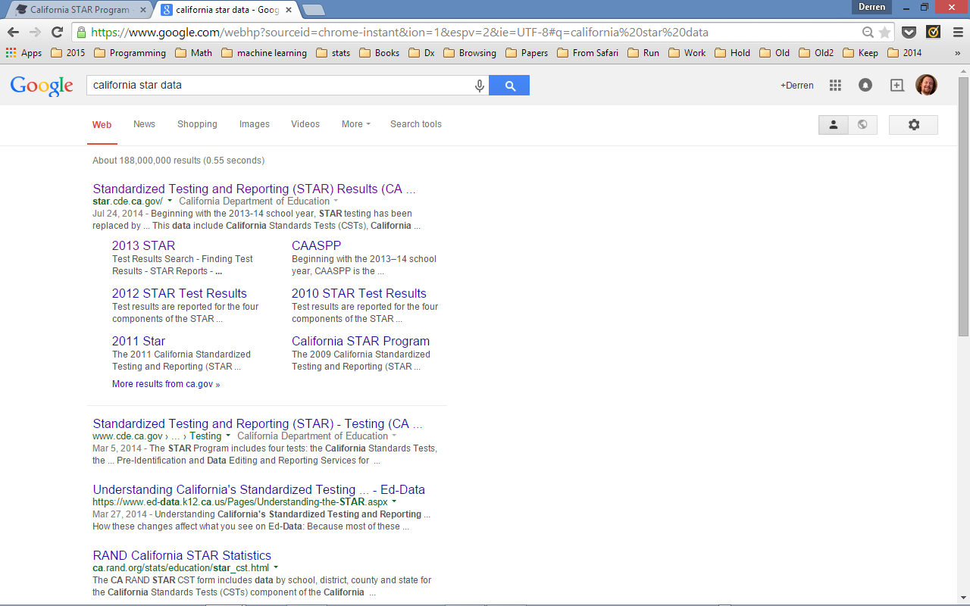
To find the data I.R.L., google “california star data”

Slide 29
FunConference vs IRL (In Real Life)
In Real Life, this data has to be cleaned up in various ways before we use it.
However, if we go through all the data preprocessing, we won't get to do any analysis today!
Therefore, we are going to use an "analysis-ready" dataset:
Please download it now.

Slide 30
A Word of Warning
There's a saying among military historians:
Amateurs talk strategy but professionals talk logistics.
Here's my version for machine learning:
Amateurs talk algorithms but professionals talk data quality.
The data munging skill is extremely important.
How clean is your data?
Where did it come from?
How was it constructed?
Where are the landmines?
If you want to do data analysis, and you don’t have a lot of experience already, you really should try your hand at preparing the data for yourself. See the appendix for some pointers.
There is no traffic jam on the extra mile…
Ok, back to our story…

Slide 31
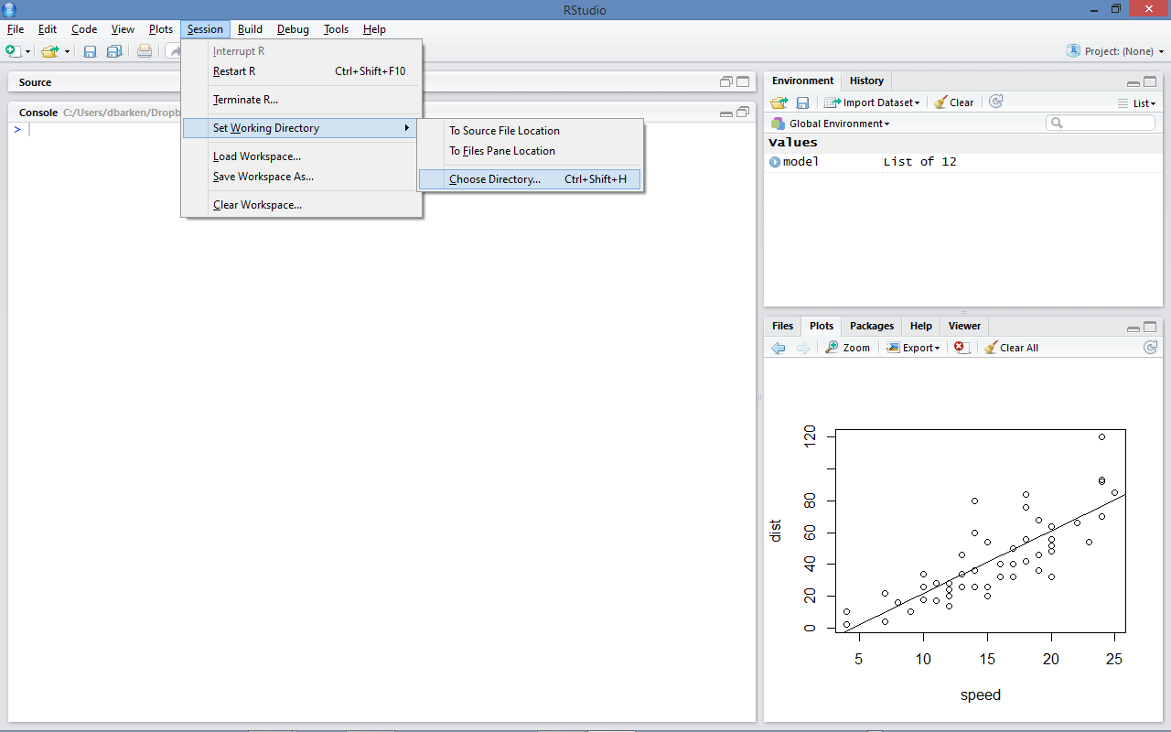
Once you’ve downloaded your data file, you need to import it.
To do that, switch to the directory where you saved your file…

Slide 32
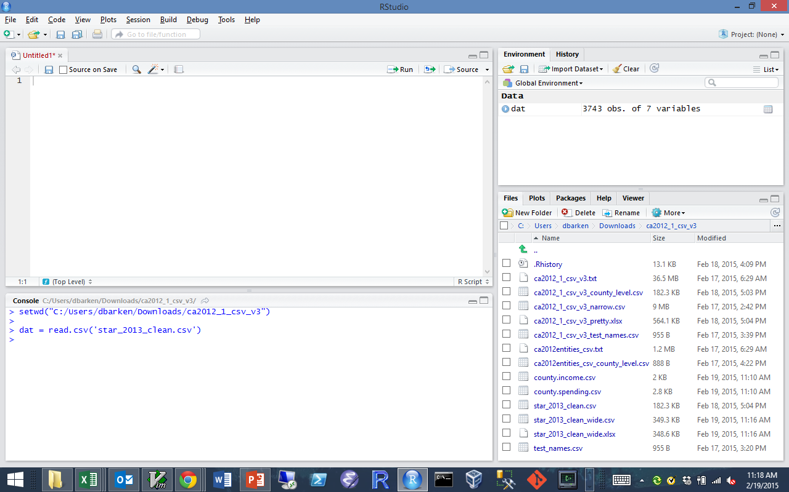
The command to bring in CSV data (worth memorizing):
variable_name = read.csv(‘filename.csv’)

Slide 33
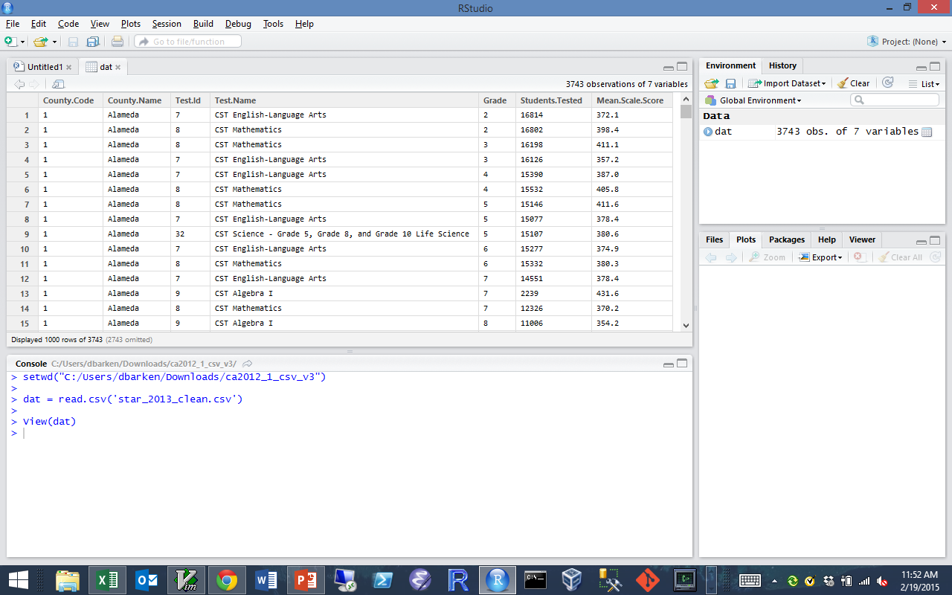
Clicking on “dat” in Panel 3 (the Environment tab)
brings up a new tab in panel 1

Slide 34
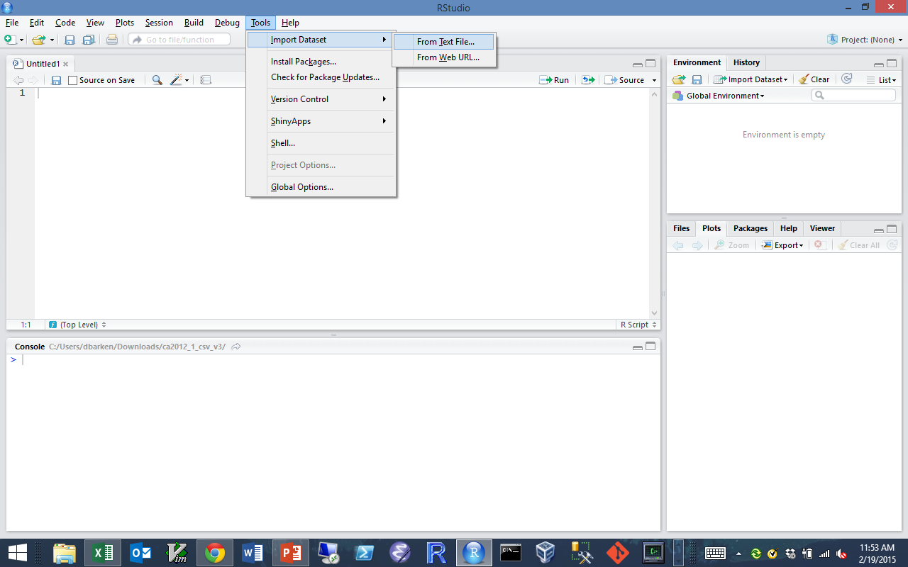
Or, RStudio has a wizard…

Slide 35
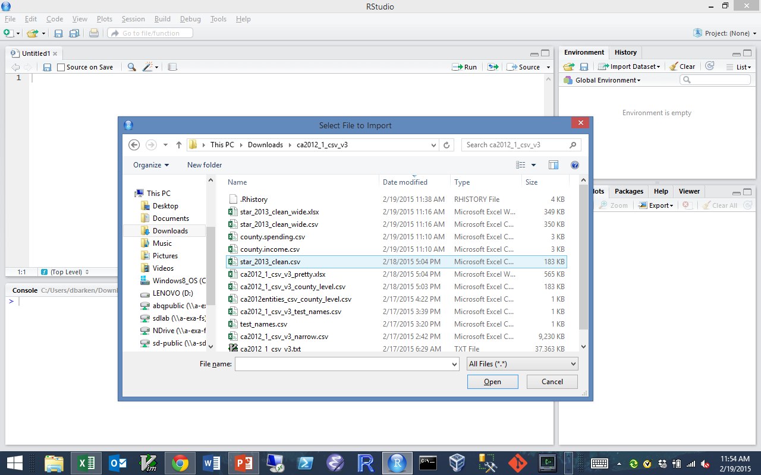
That does the usual thing…

Slide 36
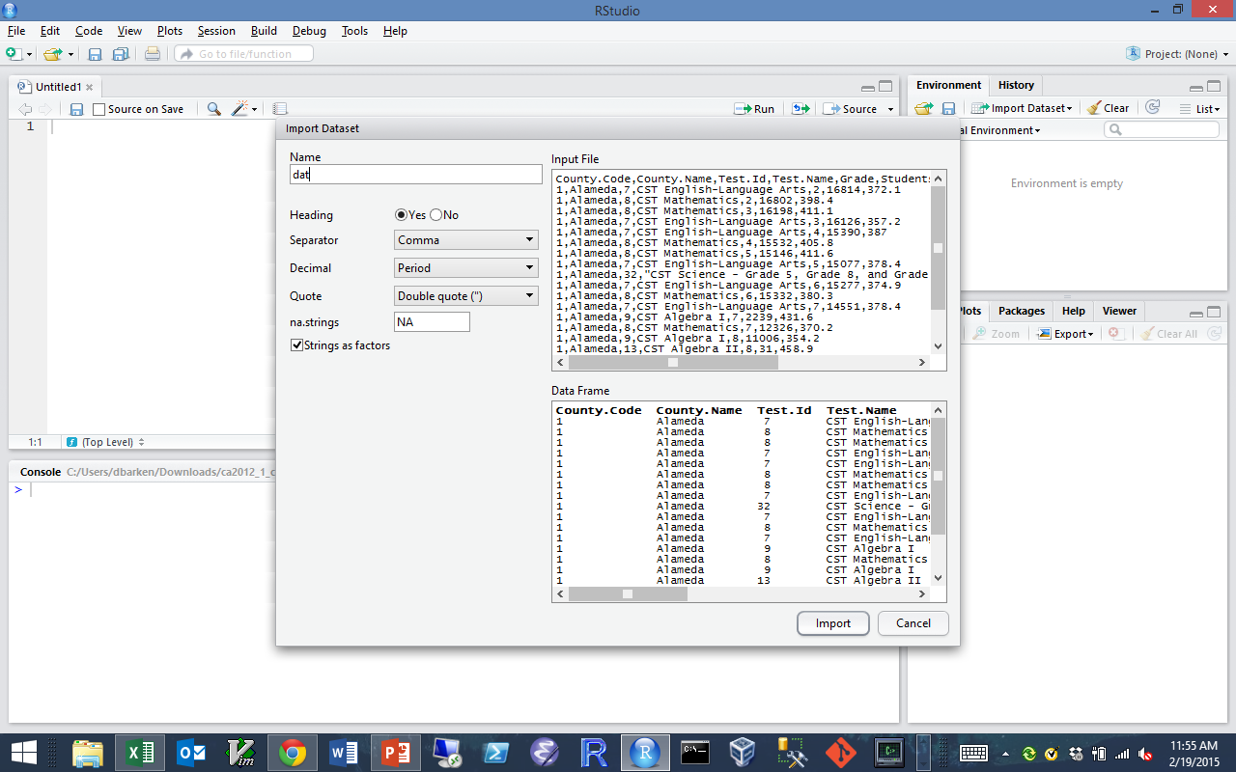
We will change the name to “dat” and hit the Import button…

Slide 37
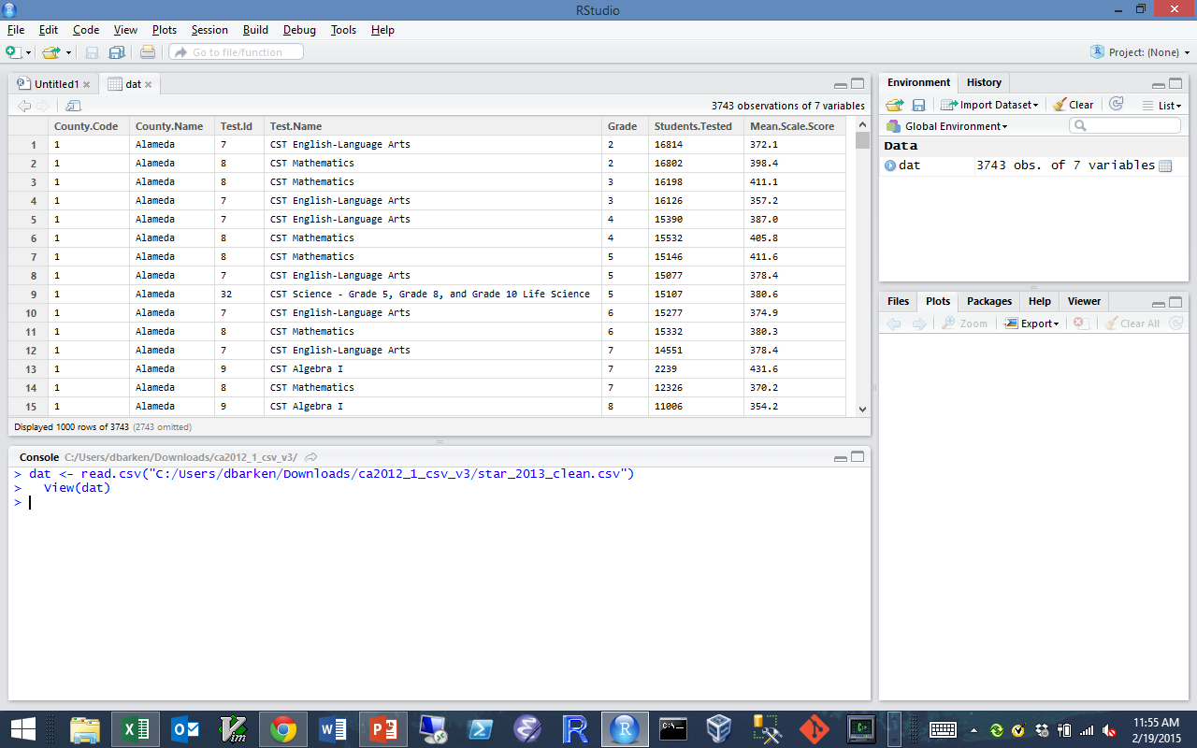
This loads the data and automatically opens a new tab…

Slide 38

Ok, we have data. Now what?
Now, we learn some basic commands and concepts in R.
We are going to learn about vectors and data frames.
After we learn a few tricks, we will come back to the STAR data.

Slide 39
VECTORS
What they are
An array of values
All of the same type
Reference by number
or
Reference by name
How to use them
grades = c('A','B','C','D','F')
grades[2] # prints "B"
grades[1:2] # prints "A" "B"
grades[c(4,4,1)] # prints "D" "D" "A"

Slide 40
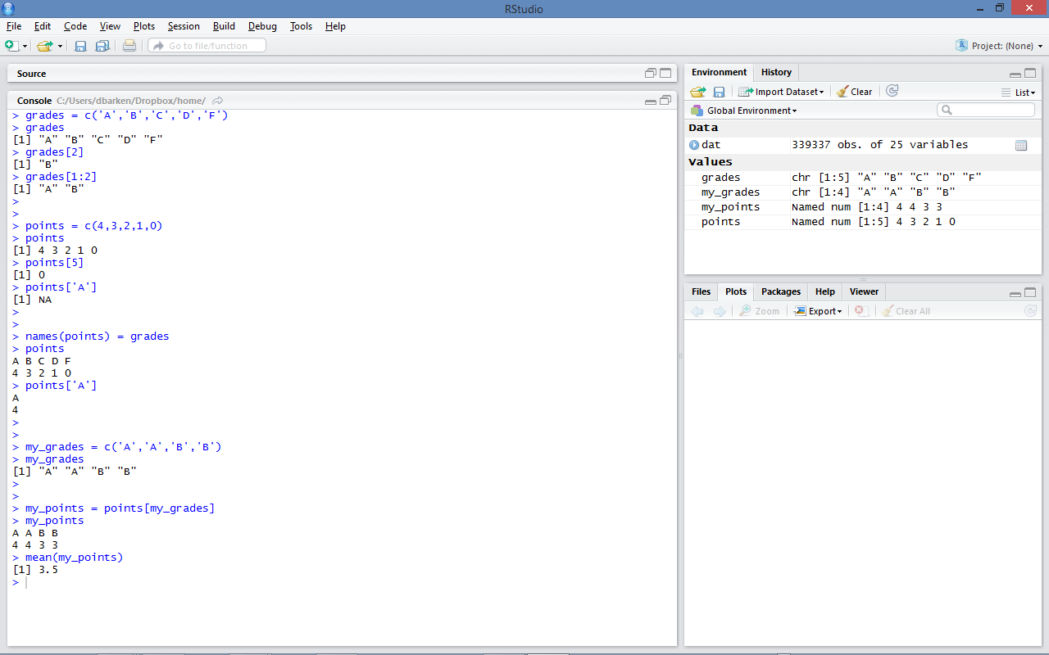
Setting and using names (with a vector)
1: grades vector
2: points vector
3: names
4: my_grades
5: my GPA

Slide 41
Data Frames
What they are
An table/grid of values
Each row is an observation
Each column is a variable
Each column has the same type
Usually imported with read.csv()
Both rows and columns can be
referenced by number or name
An example
> students =data.frame(
name =c("Ari", "Brett", "Cathy"),
math_score =c(100,50,80),
english_score=c(100, 80, 90))
>
> students
name math_score english_score
1 Ari 100 100
2 Brett 50 80
3 Cathy 80 90
>

Slide 42
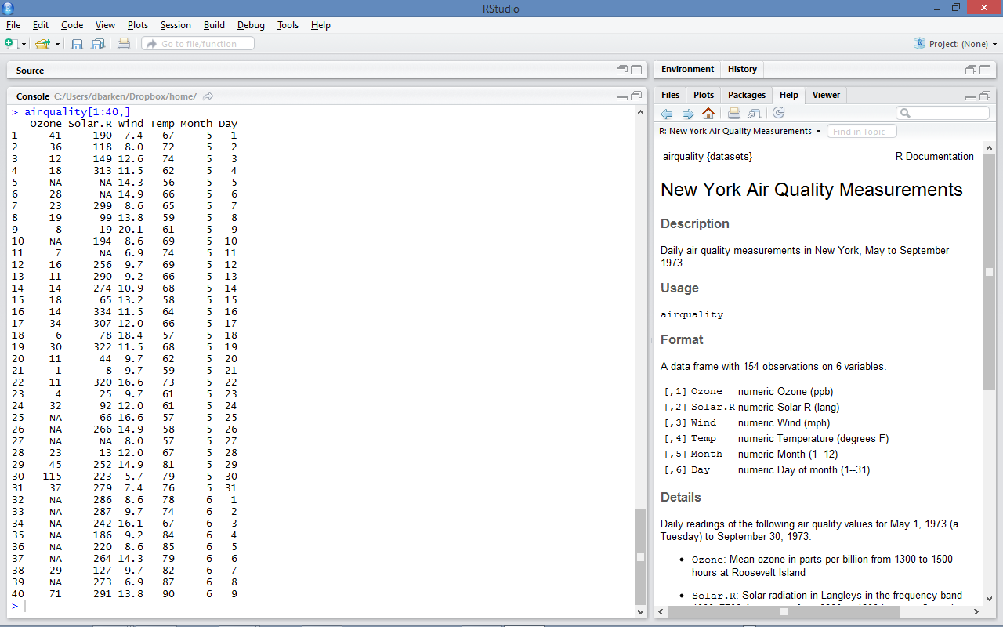
Here is the built-in data frame "airquality"
Notice the syntax: airquality[rows, cols]

Slide 43
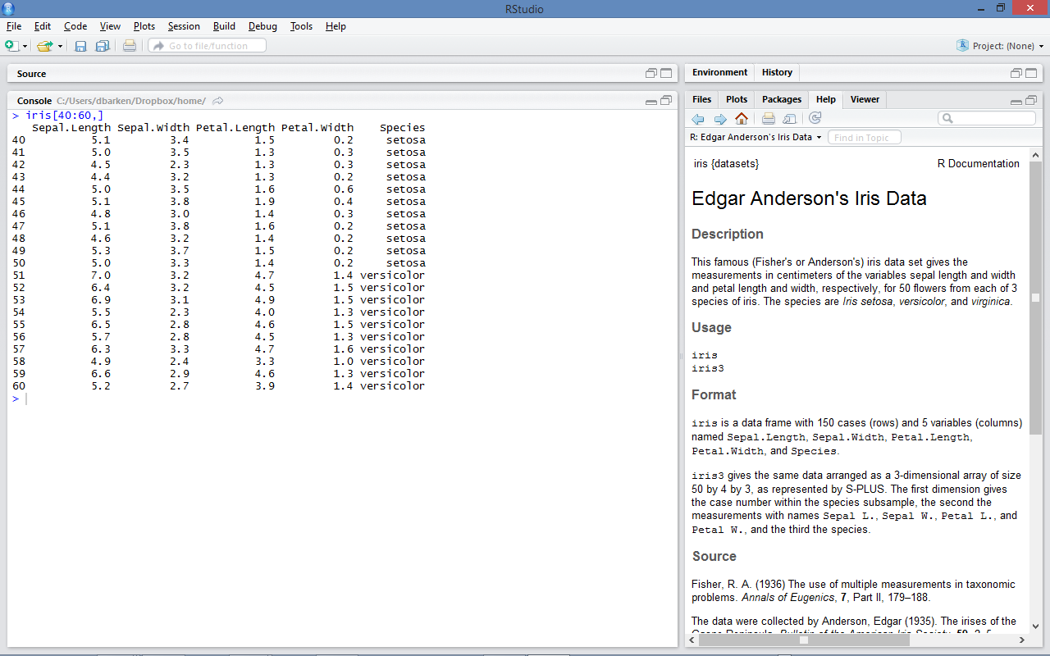
Here is the built-in (and famous) data frame "iris"
Notice that some columns are numbers, some are strings

Slide 44
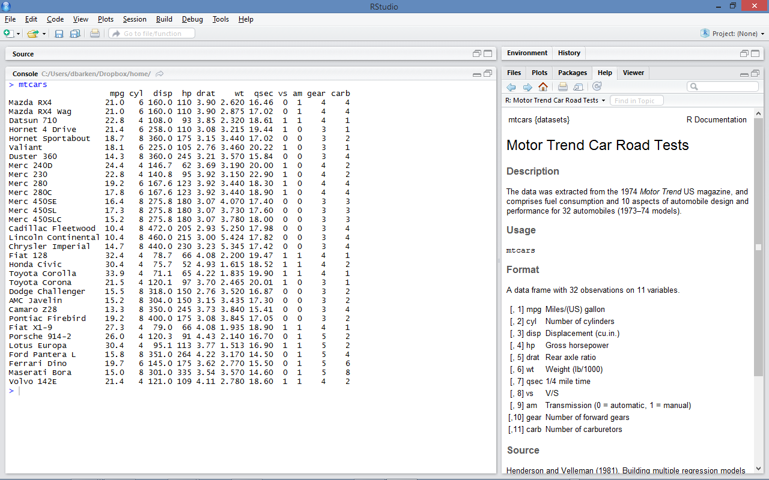
Here is the built-in data frame "mtcars"
Notice that both columns and rows have names!

Slide 45
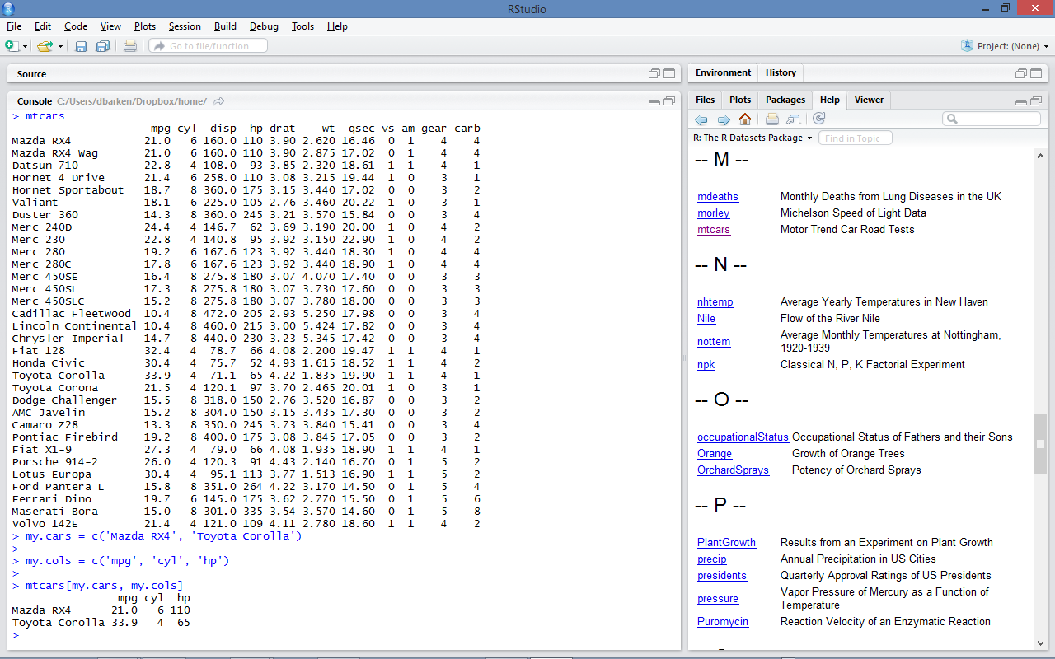
Here is an example of extracting a subset of the data frame using both row names and column names.

Slide 46
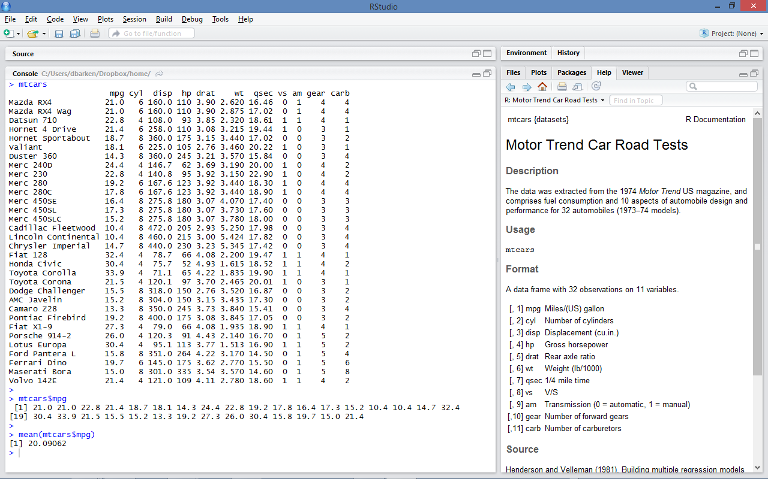
Selecting a column using "$rowname"

Slide 47
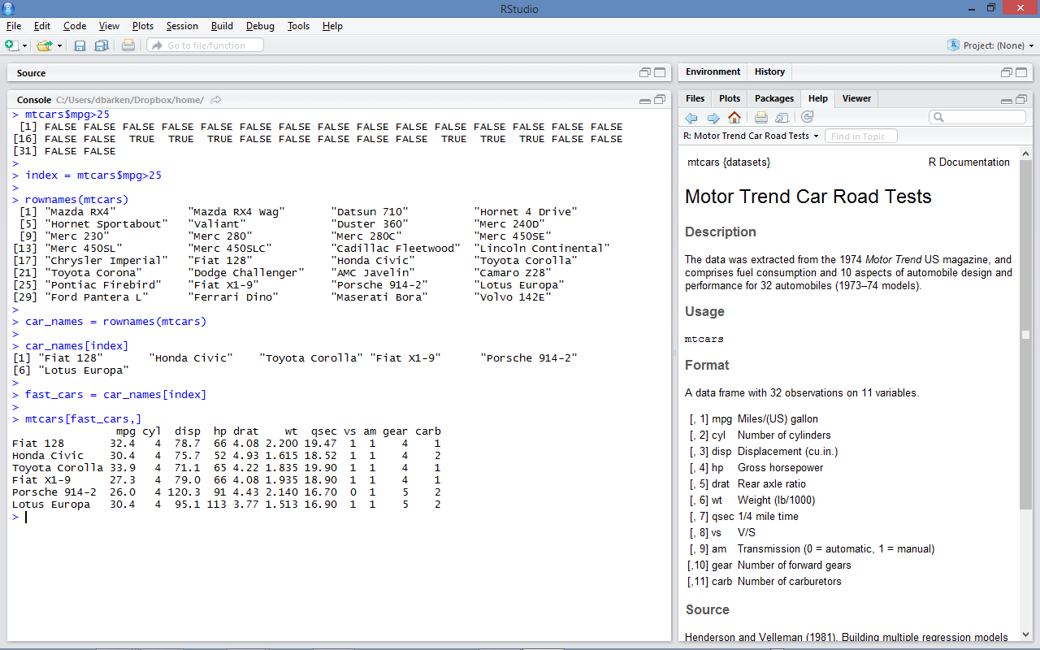
Using TRUE/FALSE vectors as indexes for data frames

Slide 48

Vectors and Data Frames, Blah Blah Blah
Can we play with some data yet?
When do I get to use my ninja skills?

Slide 49
Let's return to the Star data

Slide 50
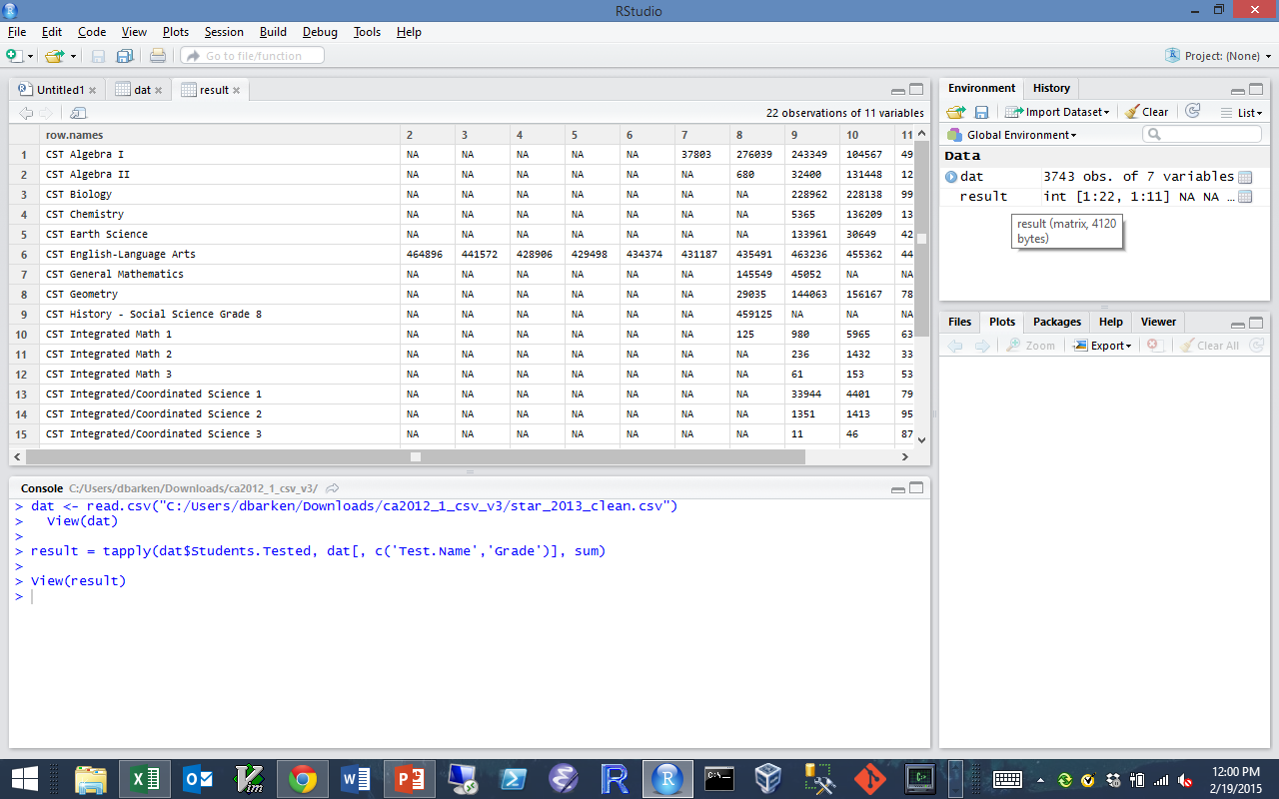
Let's look at the number of tests taken,
by test and by grade

Slide 51
Use this button to open this data in its own window

Slide 52
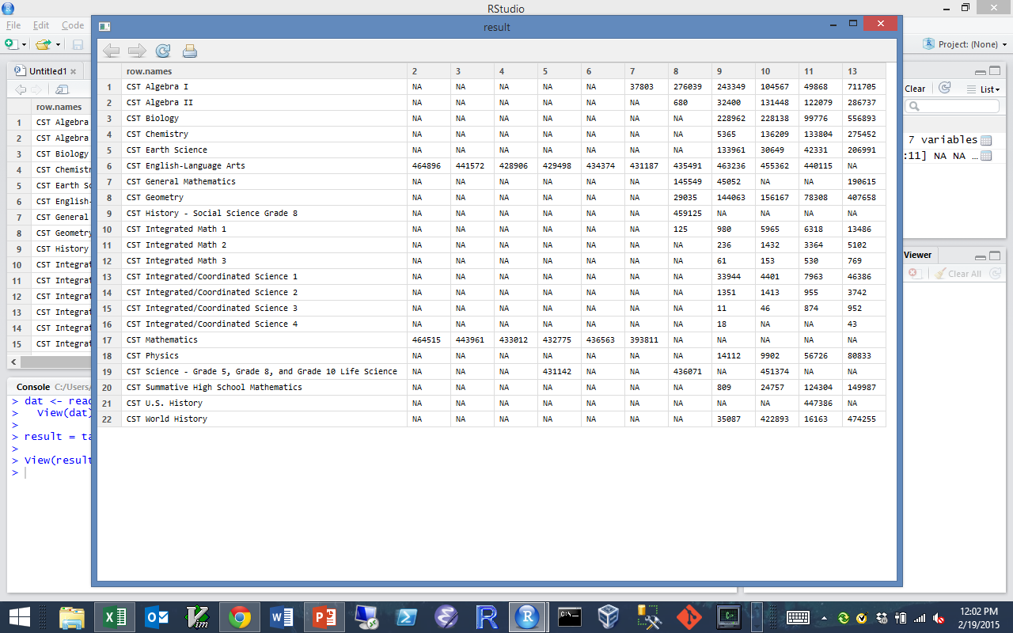
A little better, but still not great.

Slide 53
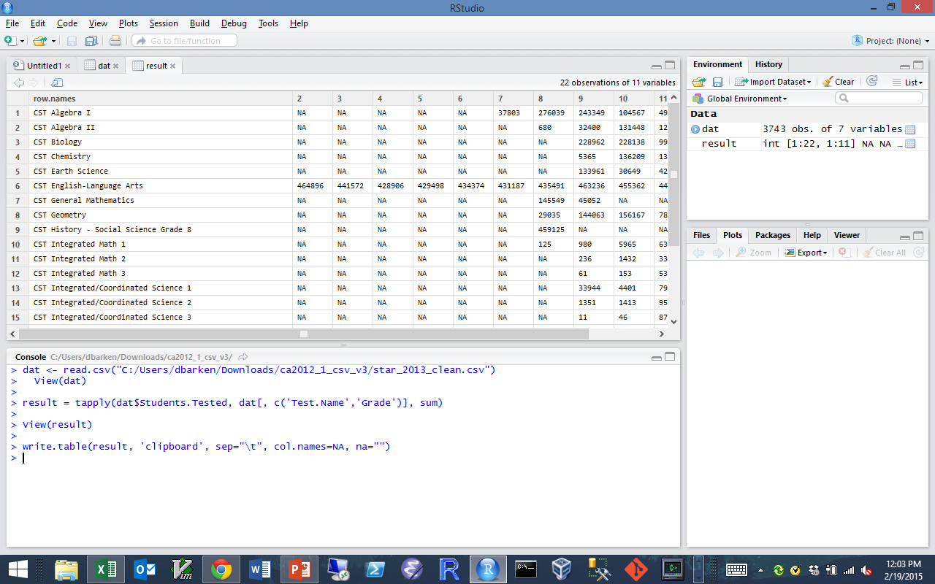
Here's a command to put the data into the clipboard…

Slide 54
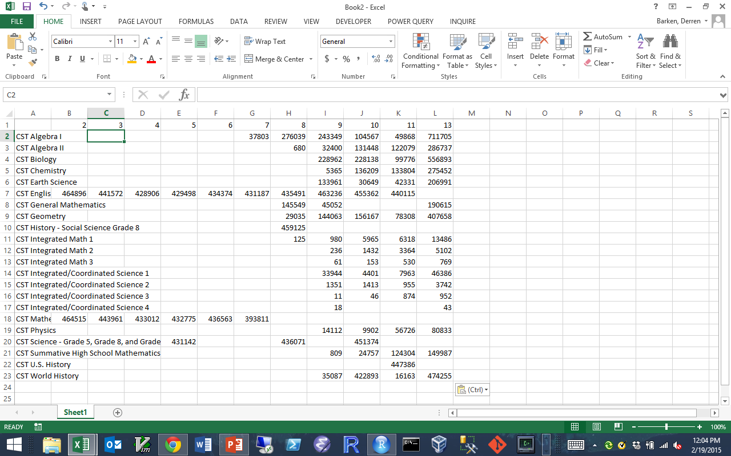
We paste it into Excel…

Slide 55
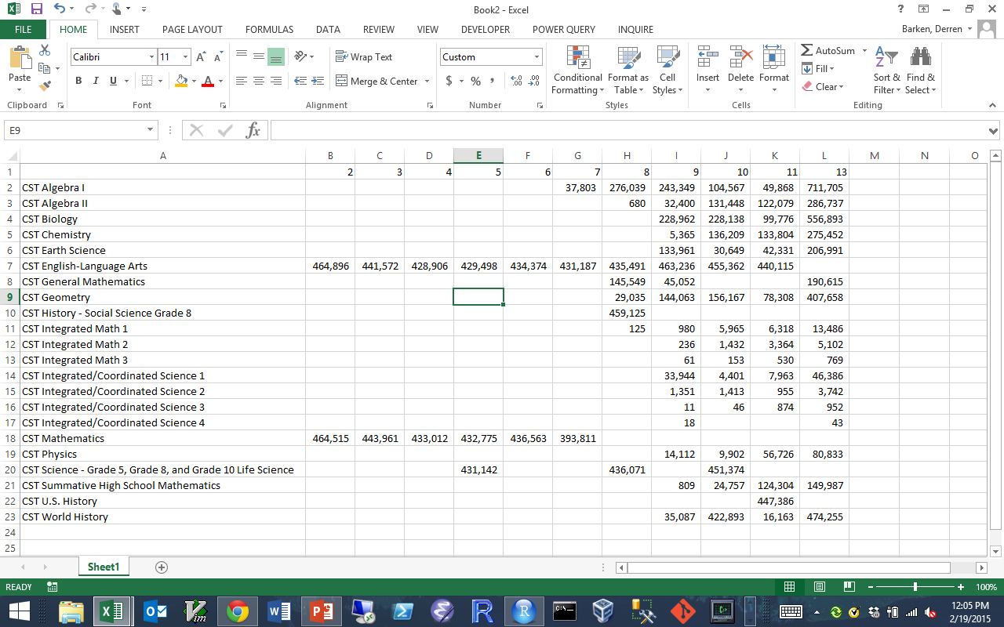
Reformat it a little…

Slide 56
Now let's inspect it…
The only data that goes all the way across is CST English-Language Arts, but…
It is missing in grade 13! (Grade 13 is a test given at graduation)
Mathematics goes all the way across, but…
it changes (splits?) at grade 8! from CST Mathematics to CST Algebra I, CST Alegebra II, CST Geometry, etc
We might like to make the comparison for Math, English and Science at grades 5, 8, and 10, but…
What do we use for Mathematics in grade 10?

Slide 57
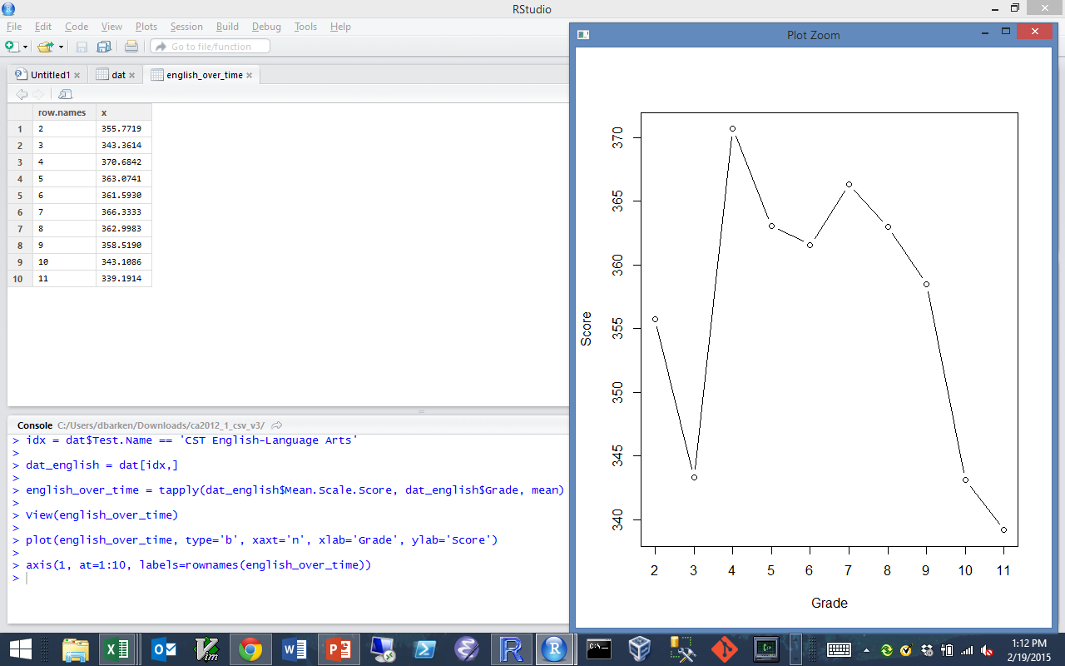
Let's do some simple analysis… what is the average English score over time?
Here's the wrong way to do it ☺ Can you say why it is wrong?

Slide 58
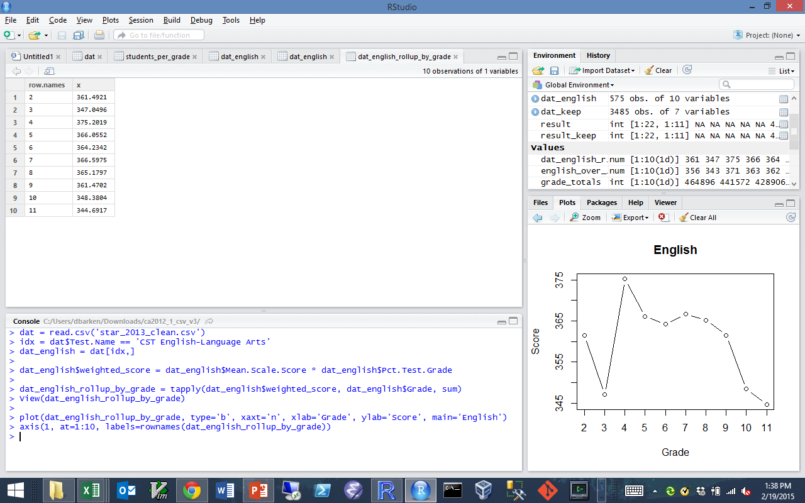
We don't want the average across counties, we want the average across students
Let's try that again.

Slide 59
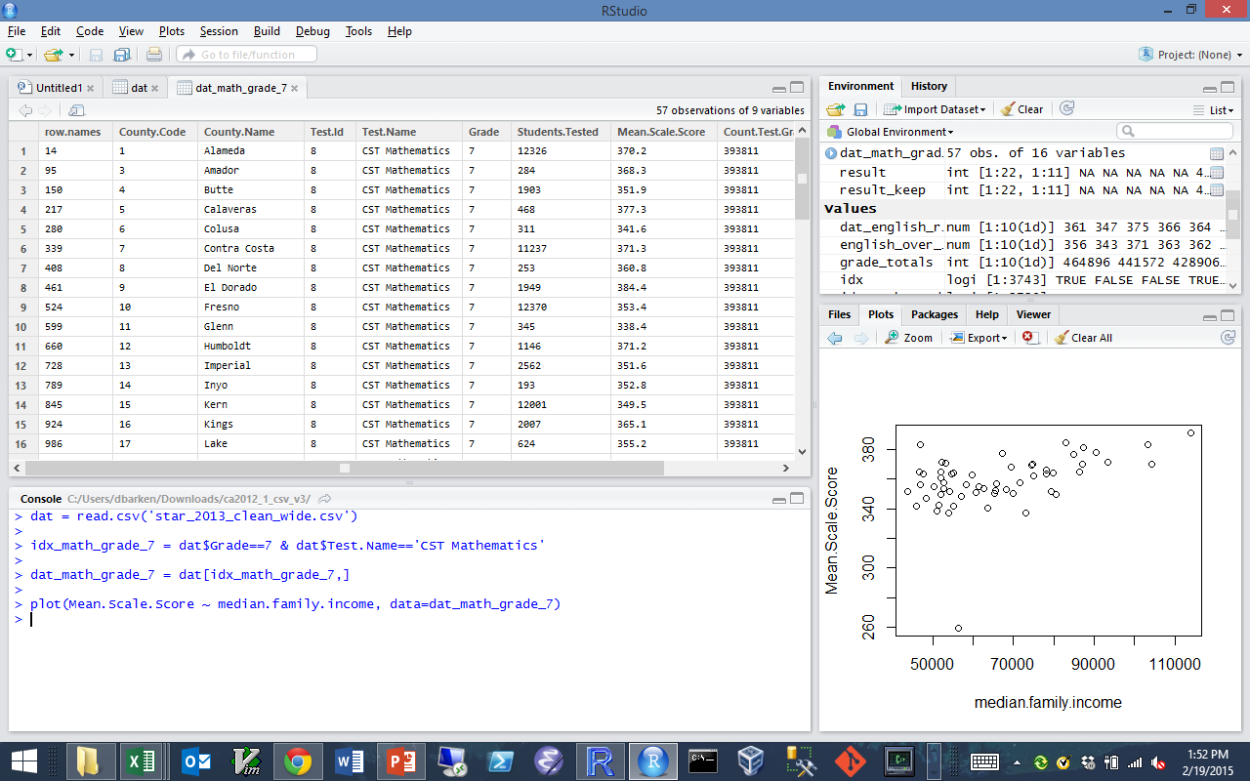
Ok, how about something more complicated?
Let's compare a county's median income and its General Math scores in grade 7

Slide 60
WTF?

Slide 61

Oh.

Slide 62
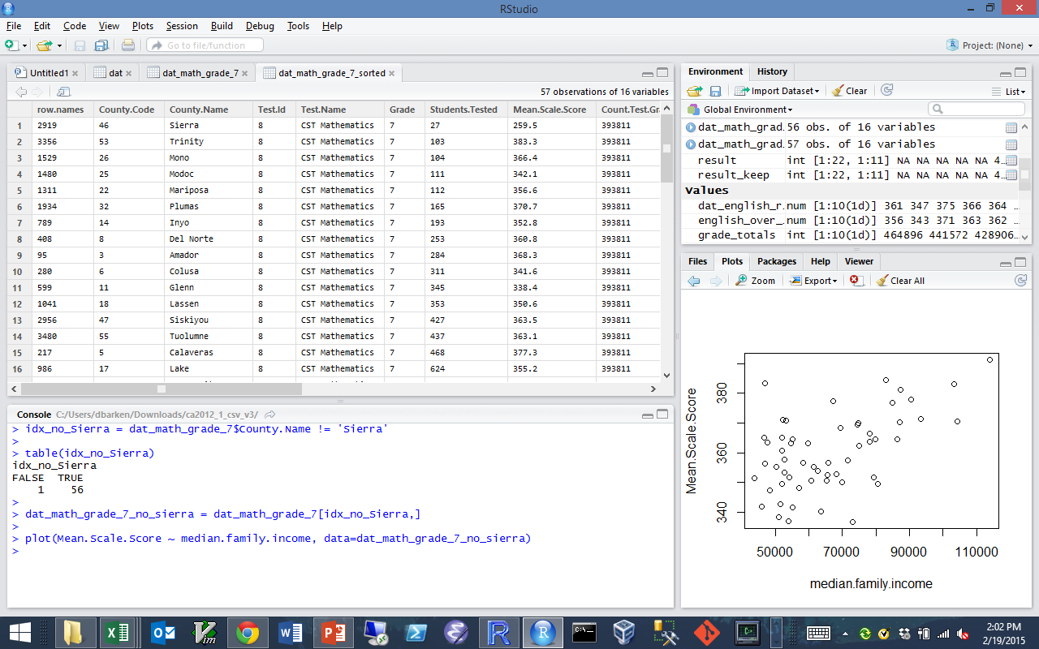
Let's try that again…
We take out the Sierra outlier, and… better.

Slide 63
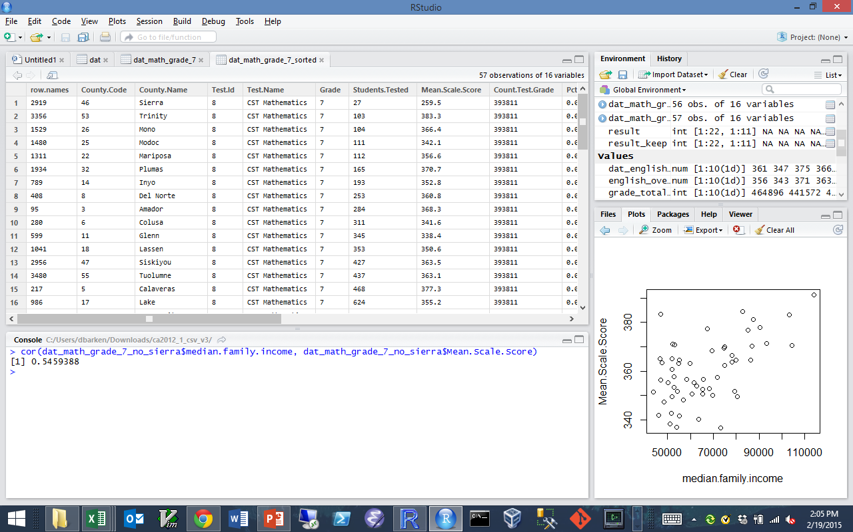
What's the correlation?

Slide 64
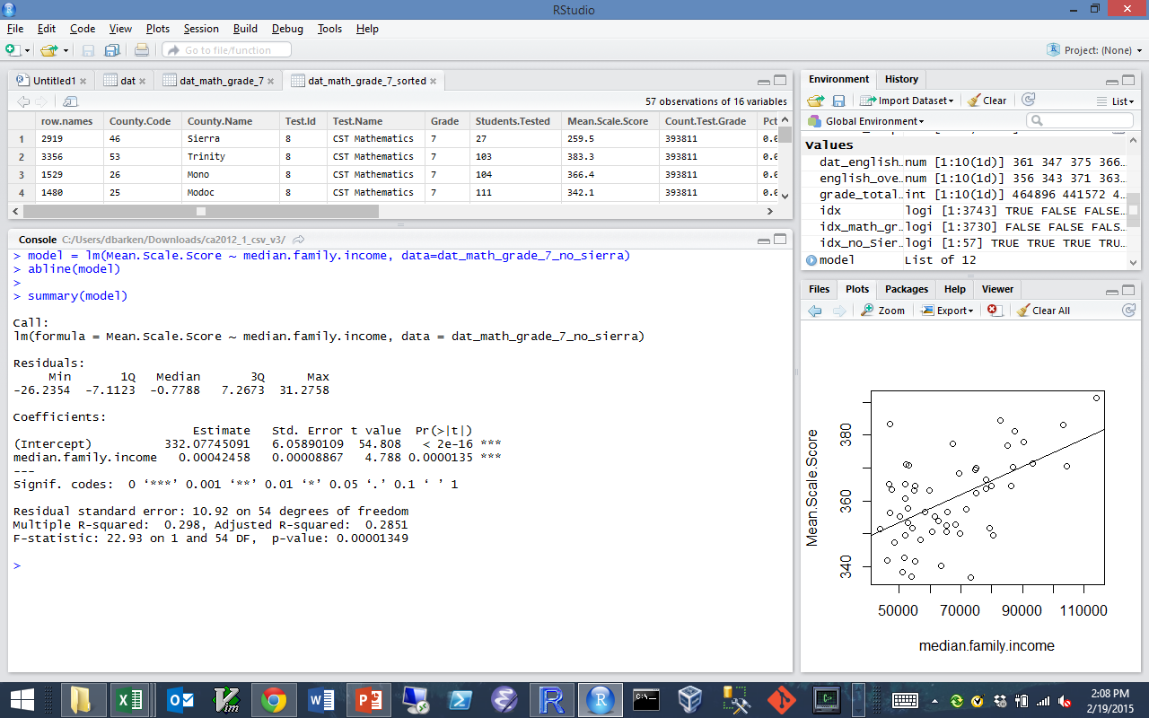
Can you fit and draw a linear regression?

Slide 65
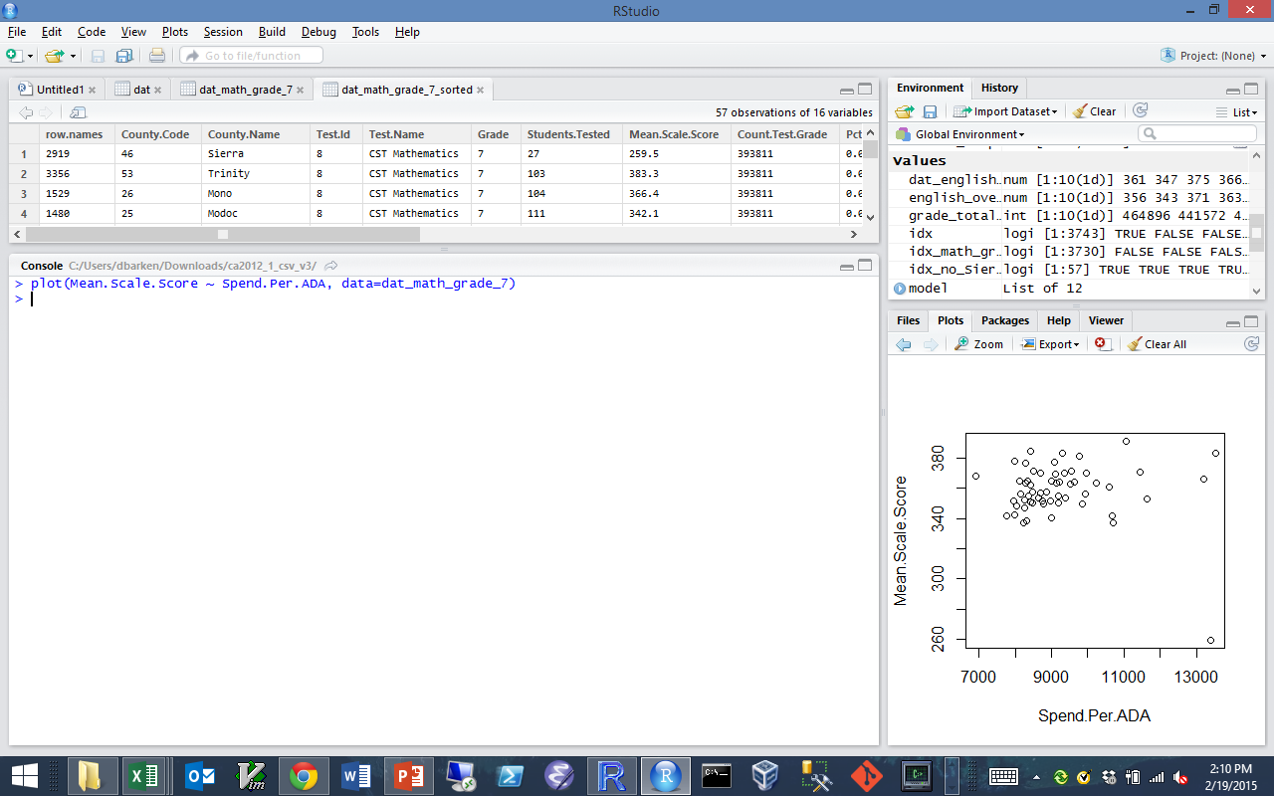
Ok, so that was family income.
What about spending per pupil?

Slide 66
WTF?

Slide 67
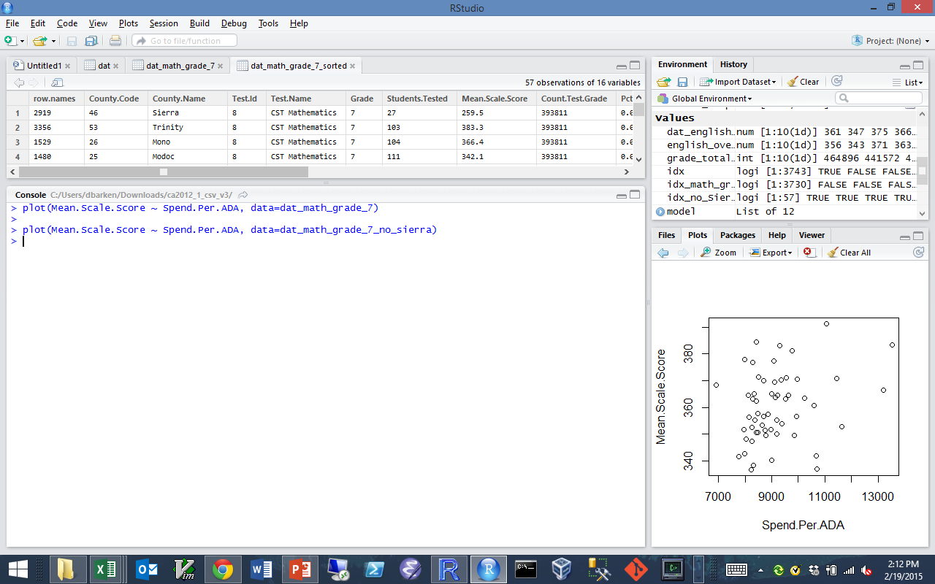
Must be that Sierra outlier.
Let's take it out, and… better.

Slide 68
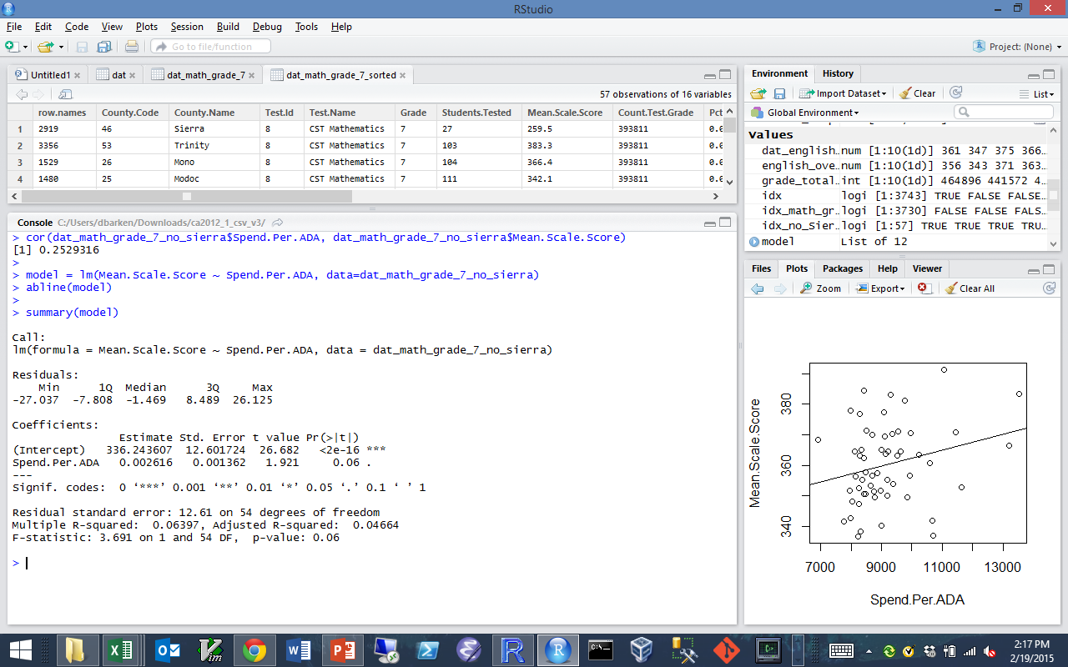
Now, how about the correlation?
The regression model?

Slide 69
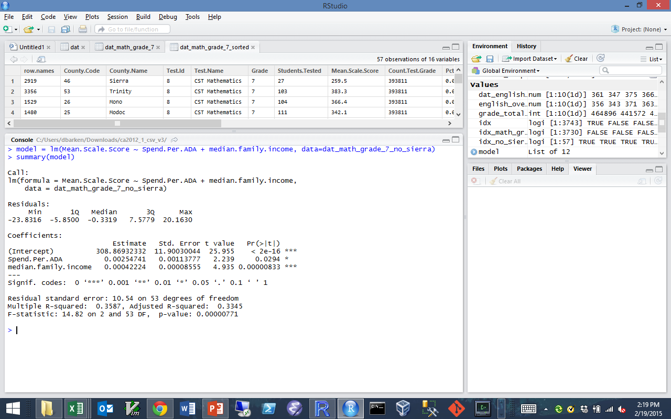
Not as good. Hmm.
Ok, then what about both income and spending together?

Slide 70
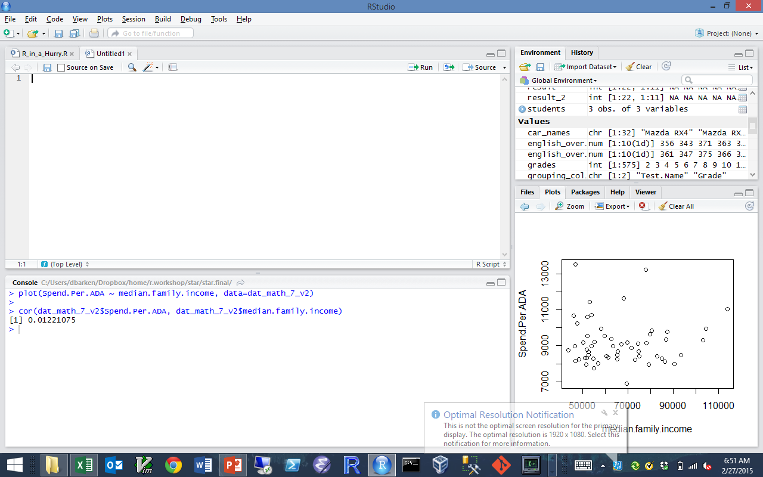
Wait! Are income and spending correlated?
Er, no.

Slide 71

Enough! I scoff at your puny analysis.
Stand aside and let me try! ☺
Let's look at the handout for hour 2…

Slide 72
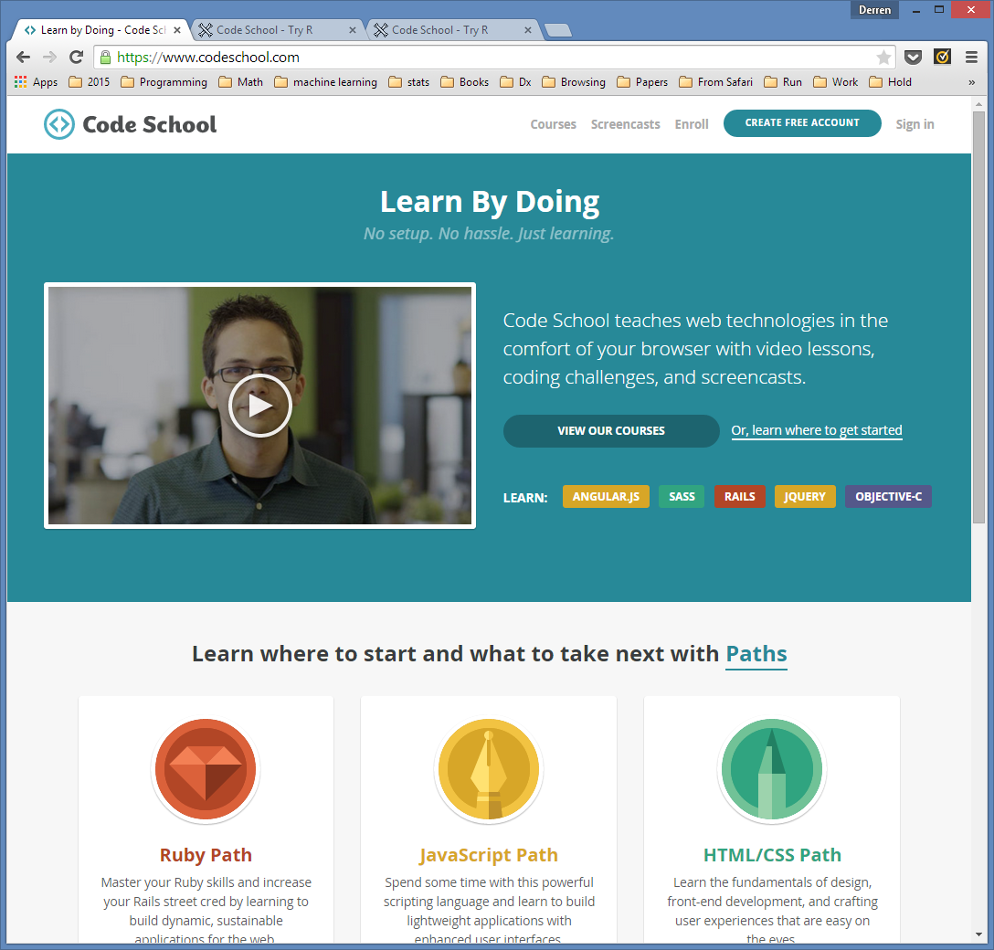

Resources – Code School

Slide 73



Resources – Books

Slide 74




Resources – Cheat Sheet

Slide 75
Appendix: Munging the STAR data

Slide 76
To find the data I.R.L., google “california star data”

Slide 77

Then choose 2013…

Slide 78

Then choose “Research Files”…

Slide 79

Download the All Students, comma delimited file

Slide 80

Here is how the data looks in Excel. Columns A-K

Slide 81

Here is how the data looks in Excel. Columns L-T

Slide 82

Here is how the data looks in Excel. Columns U-Y

Slide 83

We don't need all those columns.
Here is the list of columns. The ones we need are in yellow.

Slide 84

Here is how we can make a data frame with only the columns we need.

Slide 85

This file has data at the County, District, and School Level.
Right now, we only want the County level data.
A filtered view of the data is to the left.
This view shows grade 5, test 7 only.
Take a close look at the first two columns.
The first row, with county code equal to 0, holds summed totals for everybody.
The second row, with county code 1 and district code 0, has the summed totals for district 1 (Alameda).
The third row, with county code 1 and district code 10017, has data for a district within Alameda.
We want county level data only.
So we want the rows where district equals 0 and county does not equal 0.

Slide 86

Here is how that district filter looks in Excel.
How would we do this in R?

Slide 87

Like this. (Using an index to filter the rows)

Slide 88

Those test IDs are numbers. Can we get names?
Go here…

Slide 89

Then here…

Slide 90

Notice what it says about Table C,
then follow the link as shown…

Slide 91

Looks promising. Now scroll down to Table C…

Slide 92

Bingo! We will need this data.
Let's copy and paste it into Excel….

Slide 93

There it is. Now we can save it as a CVS file.

Slide 94

Don't forget to change the "Save as type" to CSV.

Slide 95

We bring the test names into R as a data frame…

Slide 96

… and add a column to our dat_county data frame.
First, we have to fix a column name:

Slide 97

Then we merge the two data frames:

Slide 98

Similarly, we want district names rather than numbers.
The district names are in the second file in the zip file:

Slide 99

Again, this file has too much information
(too many columns, too many rows)
We extract what we need in R, as follows:

Slide 100

Then, we merge the two data frames:

Slide 101

But wait! There's a problem:
The scores column is not numeric!

Slide 102
Fixing this problem is left as an exercise to the reader…

Slide 103

California income information online

Slide 104


Slide 105

California education spending information online

Slide 106


